Slide 1
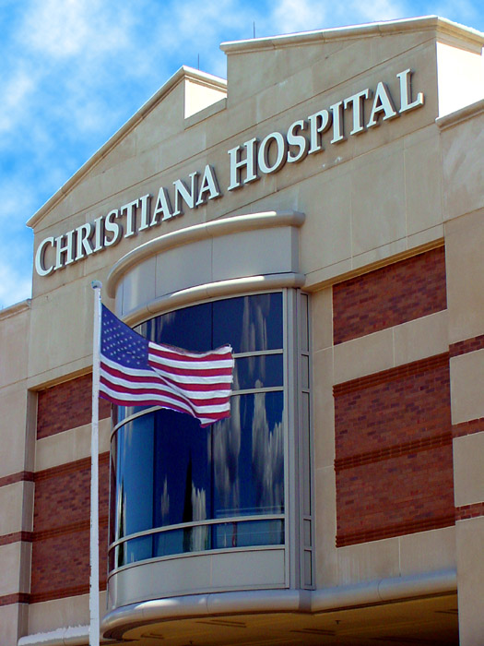
Poster Template for a 30x40 Poster
Author Name
Christiana Care Health System, Newark, DE
INTRODUCTION TO THE POSTER TEMPLATE
This template was sized to produce a poster to fit a 30x40 inch foam-core poster board. Under the Design Tab (above), and the Page Setup button, you will see the Powerpoint (Ppt) slide is sized for 30x40 inches. Do not change the slide size because Ppt has limitations. If you want a poster of another size, please call me, Douglas Bugel, 733-3642, and request a custom template.
DISCUSSION
Creating a file for Poster submission to The Learning Institute poster printing department of Christiana Care Health System
Note: Poster printing services are only available to CCHS employees, or students working with CCHS employees.
Note: All posters will have a CCHS logo on them.
Note: All posters will have a credit line saying the poster has been printed by Christiana Care Health System, and the date.
Information you should gather before requesting a Powerpoint Poster Template (Template) includes the following items.
Who is the primary author of the poster?
Who is the contact person for the poster?
Who will be the person picking the poster up, and will the poster be bundled with others?
What size is the presentation space for the poster, and what is the poster size to be placed on it?
Where will the poster be placed? Please include the conference name and City / State.
When are you leaving for the conference with the poster?
Have you ever presented a poster from CCHS before?
Email dbugel@christianacare.org with the information in Item #1, and in the reply email you will find a poster template, or a request for more information. Please do not change the slide size of the template because it is sized for our printer to produce the poster size you requested.
Open the email with the Template, and save the Template.
Reopen it and Rename it, and Resave it for your current use.
Choose a design for your sample text box and size it for the column width. Select it and duplicate it, then copy and paste your text into them.
CHOOSE HEADINGS FOR YOUR DATA.
Abstract -
Background -
Conclusion -
Data Collection -
Data Analysis -
Design -
Discussion -
Findings -
Funding Organization -
Hypothesis / Purpose -
Implications -
Methods -
Objectives -
Outcome -
Participants -
Results -
Research Question -
Settings -
Statistical Analysis -
Study Design -
Study Sites -
Study Population -
Title, Author/s, Institutional Affiliation - .
Note: If you must know everything about poster making, try:
http://www.kumc.edu/SAH/OTEd/jradel/Poster_Presentations/110.html
OBJECTIVES / PURPOSE
SAVE TIME BY DUPLICATING A CUSTOM DESIGN TEXT BOX
Choose the style text box you want and replace this text with your text.
Customize the design of your first text box, and duplicate it to use in other areas.
Cut and Paste text and objects from other sources, or insert objects to preserve their design. Note: The “Paste Options” box appears immediately after Pasting an object in Ppt. Please scroll through the options and choose any option EXCEPT “Picture. The “Picture” choice removes any link to edit the object.
SETTING
The office of Douglas Bugel is in 2E96A, in the Ammon Education Center, on the Christiana Hospital campus.
Poster printing is done in 2E96A, too.
METHODS
“Ready to print” poster orders are due 5 working days before the delivery day.
Posters are printed with water soluble ink.
Protect your poster with a poster tube during transit.
Poster tubes are supplied with each poster ordered.
CHARACTERISTICS OF PRESENTERS
Poster Presenters | Total
# | 322
# reported (%) | 91
Use reported (%) | 88
Medicine (%) | 44
EM (%) | 33
Surgery (%) | 11
INCIDENCE OF POSTERS ORDERED
Carnival colors
are eye catching,
but not appropriate
for scientific posters.
CONCLUSION
Our department policy does not guarantee delivery of a printed poster with less than 5 working days’ remaining at time of delivery of the file.
When the final poster file is delivered to us, we will determine at that time if we will be able to print it in the timeframe requested.
If there is insufficient time remaining and prior commitments made to other customers, the alternate choice will be to use an outside contractor who might be able to print a poster.
DISCLOSURES: There are no financial conflicts for any of the authors.
DISCUSSION ABOUT ISSUES
Many issues can be resolved with a phone call.
Other issues require an office visit.
© 2018 Christiana Care Health Services, Inc., All rights reserved

